Slide 1

FAIR USE NOTICE
The material used in this presentation i.e., pictures/graphs/text, etc. is solely intended for educational/teaching purpose, offered free of cost to the students for use under special circumstances of Online Education due to COVID-19 Lockdown situation and may include copyrighted material - the use of which may not have been specifically authorised by Copyright Owners. Its application constitutes Fair Use of any such copyrighted material as provided in globally accepted law of many countries. The contents of presentations are intended only for the attendees of the class being conducted by the presenter.

Slide 2
FINITE STATE MACHINES

Slide 3
Introduction
A requirements technique for modeling the states and transitions of a software system
Finite state machines are used in other contexts
automata theory and compilers, for example
More precise than data-flow diagrams
since data-flow diagrams specify only the nature of a system’s data flow (e.g. the what and the where)
whereas finite state machines provide information on how a system progresses from state to state .

Slide 4
Formal Definition
A finite state machine (FSM) consists of five parts
a set of states
a set of inputs
a transition function
the initial state
a set of final states

Slide 5

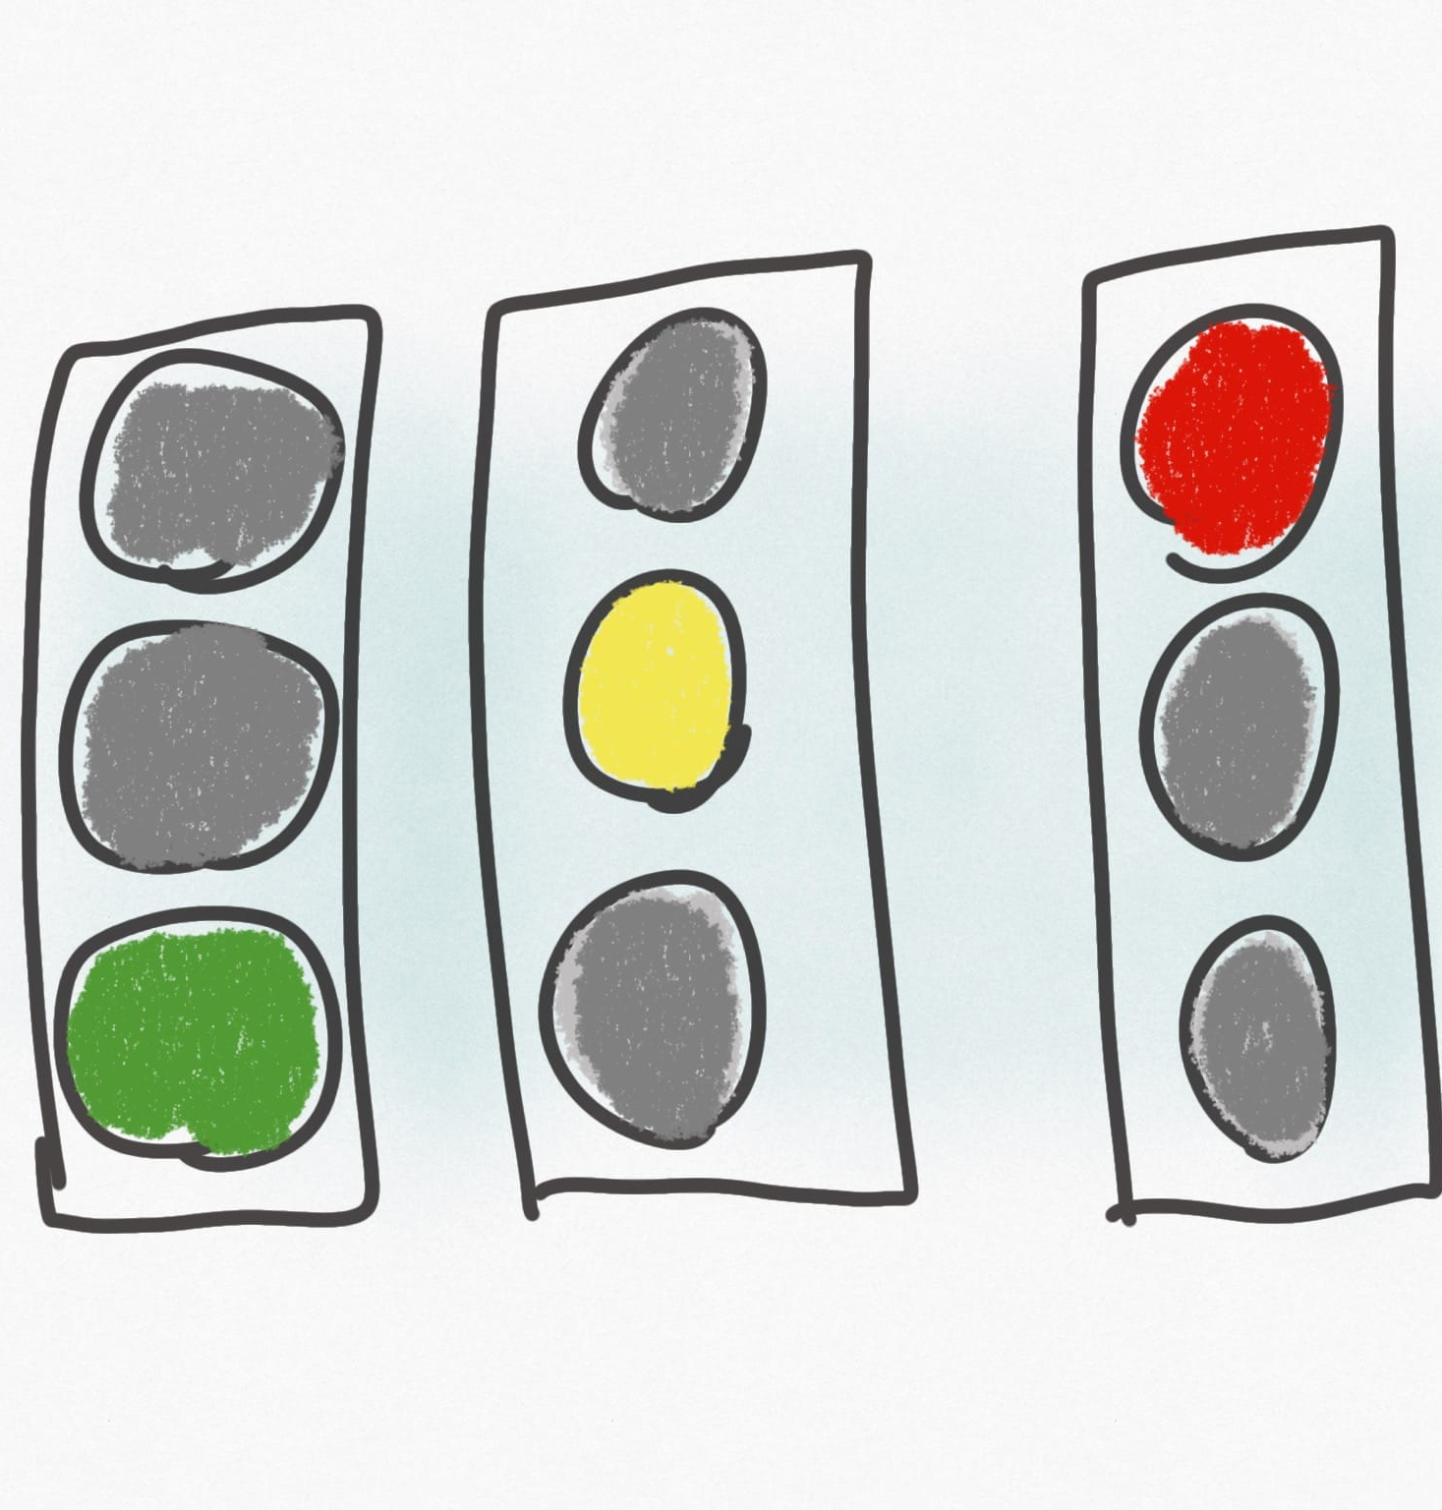
Simple Example Traffic Light
At any point in time, a traffic semaphore has a defined state. Typically, it either:
has the green light on, and the other 2 lights off
has the red light on, and the other 2 lights off
as the yellow light on, and the other 2 lights off

Slide 6
Example Contd.
If we put ourselves in the shoes of the people who had to build these, we could envision using a Finite State Machine to represent the stoplight.
We stick finite on the front state machine because
There are a finite (set number) of states (colours) that the traffic light will transition between.
There are also a finite number of actions or triggers (traffic light timers) which are then used to transition between the states.

Slide 7
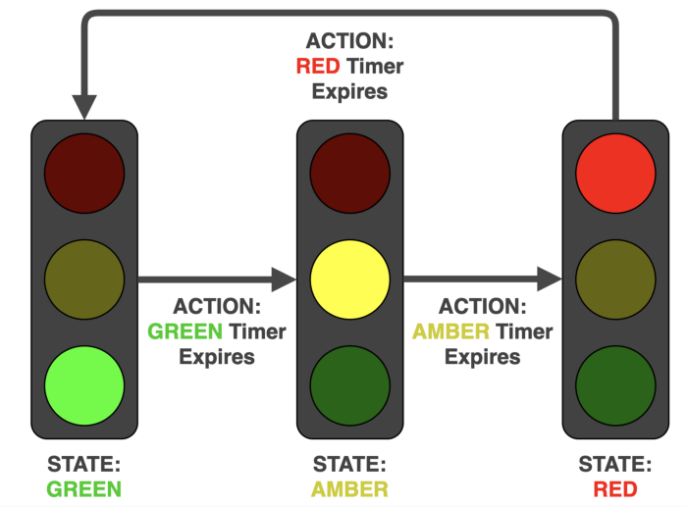
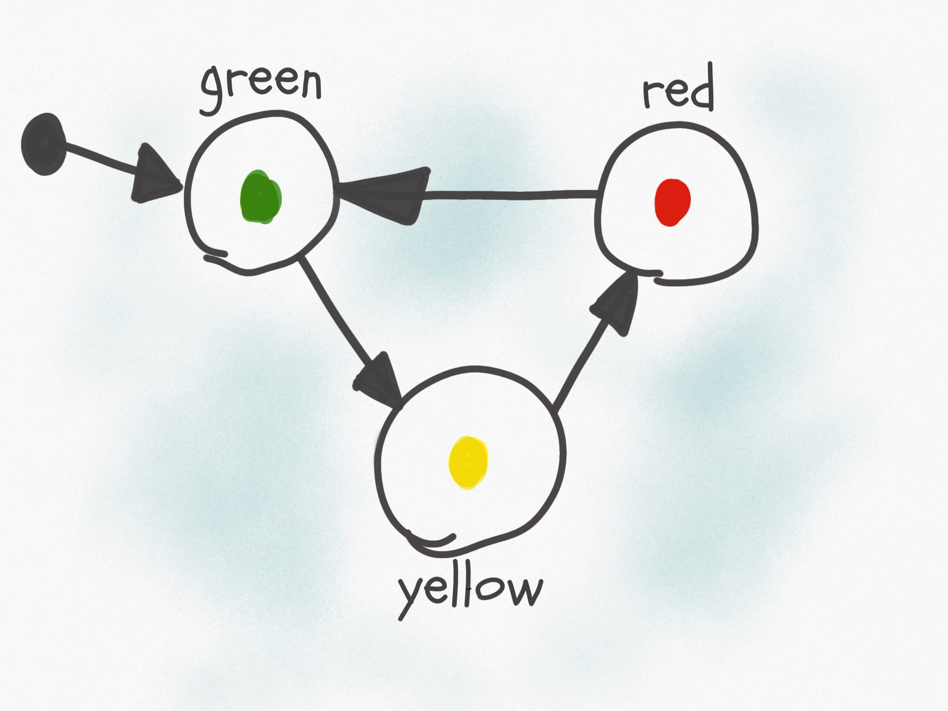
Finite State Machine for Traffic Light
Assuming green is the initial state
32s
32s
50s
8s
50s
8s

Slide 8
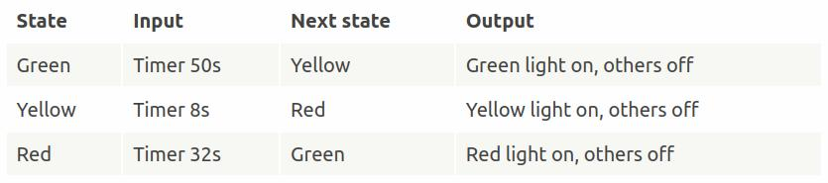
Example Contd.
We can also model it with a state transition table, which shows the state the machine is currently in, what is the input it receives, what is the next state, and the output:

Slide 9
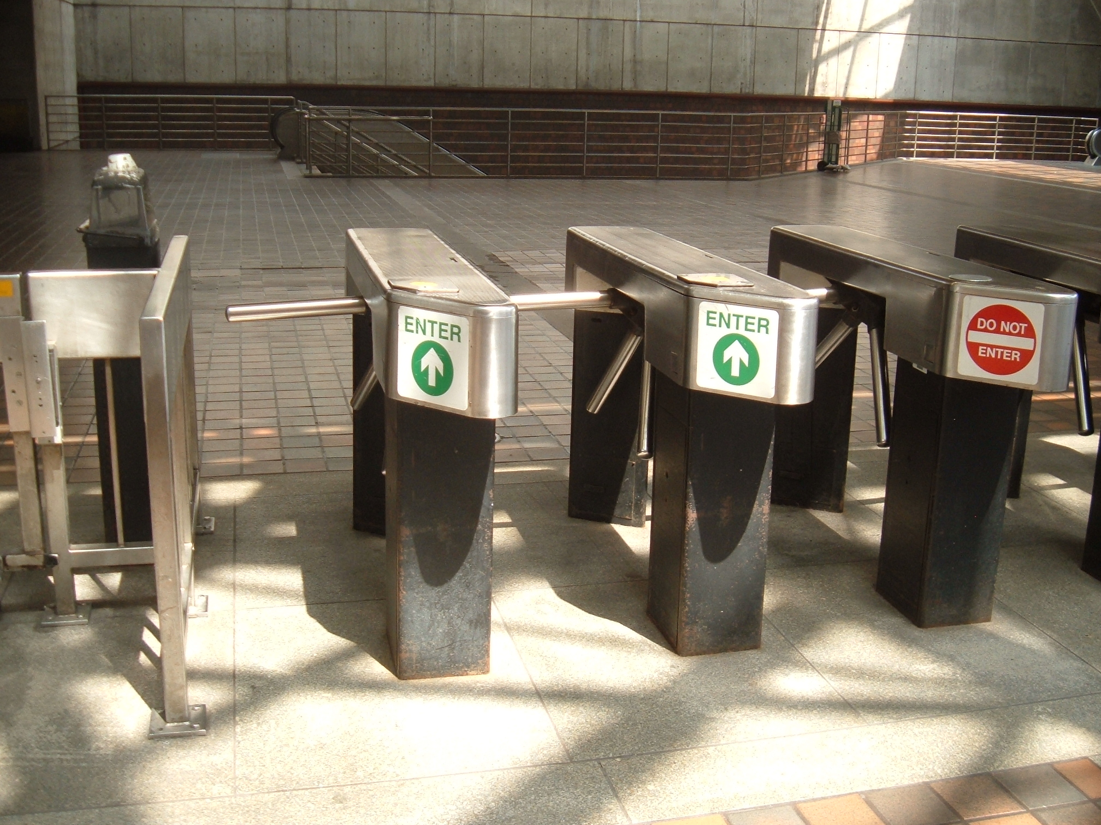
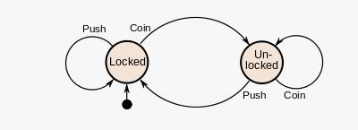
Example: Turnstile (FSM)
Inserting a coin into a turnstile will unlock it
After the turnstile has been pushed, it locks again.
Inserting a coin into an unlocked turnstile,
or pushing against a locked turnstile
will not change its state.

Slide 10
Example: EFTPOS System (FSM)
(EFTPOS= Electronic Fund Transfer Point of Sale)
Initial
1 digit
d1
1 digit
d2
1 digit
d3
1 digit
d4
OK
OK
OK
OK
OK
OK
pressed
Rejected
Reject
approve
Initial state
Approved
Final state

Slide 11
PETRI NET METHOD

Slide 12
Introduction
First introduced by Carl Adam Petri in 1962.
A diagrammatic tool to model concurrency and synchronization in distributed systems.
Very similar to State Transition Diagrams and Finite State Machines.
Used as a visual communication aid to model the system behavior
Based on strong mathematical foundation.

Slide 13
Recall Example: EFTPOS System (FSM)
(EFTPOS= Electronic Fund Transfer Point of Sale)
Initial
1 digit
d1
1 digit
d2
1 digit
d3
1 digit
d4
OK
OK
OK
OK
OK
OK
pressed
Rejected
Reject
approve
Initial state
Approved
Final state

Slide 14
Example: EFTPOS System (A Petri net)
1 digit
1 digit
1 digit
1 digit
d4
Initial
d1
d2
d3
OK
OK
OK
OK
OK
OK
pressed
Rejected!
Reject
approve
approved

Slide 15
EFTPOS System
Scenario 1: Normal
Enters all 4 digits and press OK.
Scenario 2: Exceptional
Enters only 3 digits and press OK.

Slide 16
Example: EFTPOS System (Token Games)
1 digit
1 digit
1 digit
1 digit
d4
Initial
d1
d2
d3
OK
OK
OK
OK
OK
OK
pressed
Rejected!
Reject
approve
approved

Slide 17
A Petri Net Specification ...
consists of three types of components: places (circles), transitions (rectangles) and arcs (arrows):
Places represent possible states of the system;
Transitions are events or actions which cause the change of state; And
Every arc simply connects a place with a transition or a transition with a place.

Slide 18
A Change of State …
is denoted by a movement of token(s) (black dots) from place(s) to place(s); and is caused by the firing of a transition.
The firing represents an occurrence of the event or an action taken.
The firing is subject to the input conditions, denoted by token availability.

Slide 19
A Change of State
A transition is firable or enabled when there are sufficient tokens in its input places.
After firing, tokens will be transferred from the input places (old state) to the output places, denoting the new state.
Note that the EFTPOS example is a Petri net representation of a finite state machine (FSM).

Slide 20
Example: Vending Machine
The machine dispenses two kinds of snack bars – 20c and 15c.
Only two types of coins can be used – 10c coins and 5c coins.
The machine does not return any change.

Slide 21
Example: Vending Machine (FSM)
Take 15c snack bar
5 cents
Deposit 10c
15 cents
Deposit 5c
0 cent
Deposit 5c
Deposit 5c
Deposit 5c
Deposit 10c
10 cents
Deposit 10c
20 cents
Take 20c snack bar

Slide 22
Example: Vending Machine (A Petri net)
Take 15c bar
Deposit 10c
15c
5c
Deposit 5c
Deposit 5c
Deposit
5c
0c
Deposit
5c
Deposit 10c
10c
20c
Deposit 10c
Take 20c bar

Slide 23
Example: Vending Machine (3 Scenarios)
Scenario 1:
Deposit 5c, deposit 5c, deposit 5c, deposit 5c, take 20c snack bar.
Scenario 2:
Deposit 10c, deposit 5c, take 15c snack bar.
Scenario 3:
Deposit 5c, deposit 10c, deposit 5c, take 20c snack bar.

Slide 24
Example: Vending Machine (Token Games)
Take 15c bar
Deposit 10c
15c
5c
Deposit 5c
Deposit 5c
Deposit
5c
0c
Deposit
5c
Deposit 10c
10c
20c
Deposit 10c
Take 20c bar

Slide 25
Multiple Local States
In the real world, events happen at the same time.
There is a need to model concurrency and synchronization.

Slide 26
Example: In a Restaurant (A Petri Net)
Waiter
free
Customer 1
Customer 2
Take
order
Take
order
wait
Order
taken
wait
eating
eating
Tell
kitchen
Serve food
Serve food

Slide 27
Example: In a Restaurant (Two Scenarios)
Scenario 1:
Waiter takes order from customer 1; serves customer 1; takes order from customer 2; serves customer 2.
Scenario 2:
Waiter takes order from customer 1; takes order from customer 2; serves customer 2; serves customer 1.

Slide 28
Example: In a Restaurant (Scenario 1)
Waiter
free
Customer 1
Customer 2
Take
order
Take
order
wait
Order
taken
wait
eating
eating
Tell
kitchen
Serve food
Serve food

Slide 29
Example: In a Restaurant (Scenario 2)
Waiter
free
Customer 1
Customer 2
Take
order
Take
order
wait
Order
taken
wait
eating
eating
Tell
kitchen
Serve food
Serve food

Slide 30
Net Structures
A sequence of events/actions:
Concurrent executions:
e1
e2
e3
e2
e3
e1
e4
e5

Slide 31
Net Structures
Non-deterministic events - conflict, choice or decision: A choice of either e1, e2 … or e3, e4 ...
e1
e2
e3
e4

Slide 32
Net Structures
Synchronization
e1

Slide 33
Net Structures
Synchronization and Concurrency
e1

Slide 34
Another Example
A producer-consumer system, consist of one producer, two consumers and one storage buffer with the following conditions:
The storage buffer may contain at most 5 items;
The producer sends 3 items in each production;
At most one consumer is able to access the storage buffer at one time;
Each consumer removes two items when accessing the storage buffer

Slide 35
A Producer-Consumer System
k=1
k=2
ready
accepted
p1
p4
Storage p3
produce
accept
t2
3
2
t1
t3
t4
consume
send
k=5
p2
p5
idle
ready
k=1
k=2
Producer
Consumers

Slide 36
A Producer-Consumer Example
In this Petri net, every place has a capacity and every arc has a weight.
This allows multiple tokens to reside in a place to model more complex behaviour.

Slide 37
Behavioral Properties
Reachability
“Can we reach one particular state from another?”
Boundedness
“Will a storage place overflow?”
Liveness
“Will the system die in a particular state?”

Slide 38
Recalling the Vending Machine (Token Game)
Take 15c bar
Deposit 10c
15c
5c
Deposit 5c
Deposit 5c
Deposit
5c
0c
Deposit
5c
Deposit 10c
10c
20c
Deposit 10c
Take 20c bar

Slide 39
A marking is a state ...
t8
p4
M0 = (1,0,0,0,0)
t4
p2
M1 = (0,1,0,0,0)
t1
M2 = (0,0,1,0,0)
M3 = (0,0,0,1,0)
p1
M4 = (0,0,0,0,1)
t3
t5
t7
Initial marking:M0
t6
p5
t2
p3
t9

Slide 40
Reachability
t8
p4
t4
M0 = (1,0,0,0,0)
p2
t1
M1 = (0,1,0,0,0)
M2 = (0,0,1,0,0)
p1
M3 = (0,0,0,1,0)
t3
t5
t7
M4 = (0,0,0,0,1)
p3
t6
p5
Initial marking:M0
t2
t9
M0
t1
t3
t5
t8
t2
t6
M1
M2
M3
M0
M2
M4

Slide 41
Reachability
A firing or occurrence sequence:
M0
t1
t3
t5
t8
t2
t6
M1
M2
M3
M0
M2
M4
“M2 is reachable from M1 and M4 is reachable from M0.”
In fact, in the vending machine example, all markings are reachable from every marking.

Slide 42
Boundedness
A Petri net is said to be k-bounded or simply bounded if the number of tokens in each place does not exceed a finite number k for any marking reachable from M0.
The Petri net for vending machine is 1-bounded.
A 1-bounded Petri net is also safe.

Slide 43
Liveness
A Petri net with initial marking M0 is live if, no matter what marking has been reached from M0, it is possible to ultimately fire any transition by progressing through some further firing sequence.
A live Petri net guarantees deadlock-free operation, no matter what firing sequence is chosen.

Slide 44
Liveness
The vending machine is live and the producer-consumer system is also live.
A transition is dead if it can never be fired in any firing sequence.

Slide 45
An Example
t1
p3
p1
p2
t3
t4
p4
t2
M0 = (1,0,0,1)
M1 = (0,1,0,1)
M2 = (0,0,1,0)
M3 = (0,0,0,1)
A bounded but non-live Petri net

Slide 46
Another Example
p1
M0 = (1, 0, 0, 0, 0)
M1 = (0, 1, 1, 0, 0)
t1
M2 = (0, 0, 0, 1, 1)
M3 = (1, 1, 0, 0, 0)
p2
p3
M4 = (0, 2, 1, 0, 0)
t2
t3
p4
p5
t4
An unbounded but live Petri net

Slide 47
Analysis Methods
Reachability Analysis:
Reachability or coverability tree.
State explosion problem.
Incidence Matrix and State Equations.
Structural Analysis
Based on net structures.

Slide 48
Other Types of Petri Nets
High-level Petri nets
Tokens have “colours”, holding complex information.
Timed Petri nets
Time delays associated with transitions and/or places.
Fixed delays or interval delays.
Stochastic Petri nets: exponentially distributed random variables as delays.

Slide 49
Other Types of Petri Nets
Object-Oriented Petri nets
Tokens are instances of classes, moving from one place to another, calling methods and changing attributes.
Net structure models the inner behaviour of objects.
The purpose is to use object-oriented constructs to structure and build the system.

Slide 50
An O-O Petri Net
Producer
Consumer
ready
accepted
send
Storage
accept
produce
consume
ready
Producer
Consumer
data: ITEM
data: ITEM
ITEM produce( )
ITEM accept( )
void send(ITEM)
void consume(ITEM)

Slide 51
THANK YOU!

